Slide 1
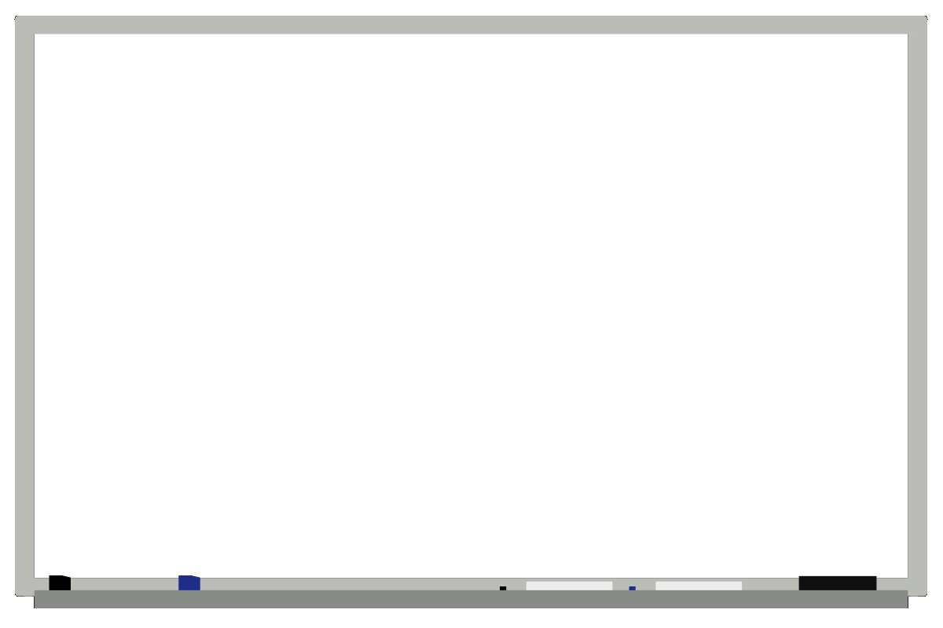

Presentation
Final Year Project: Exam Question Polling Systems
Student Name | : CHOOI CHUN YANG
Student ID | : 041140546
Supervisor Name | : VIMALA A/P DORAISAMY

Slide 2
Introduction
Definition
Exam Question Polling Systems is a web-based examination system where examinations are given online.
It’s for Candidate/Student to take the exam with a desktop or laptop device.
The system is cost effective ,scalable way to convert traditional pen and paper based exams to computerize based.

Slide 3
Motivation
The process is very slow for current Paper-Based Exam from beginning until the end of the examination.
Paper Based Exam required more man power.
The cost is necessary for hiring Man Power and stationary as Paper, Pen, Pencil and Etc.

Slide 4



Objective
Save Paper, Save Trees.
Save the Time.
Save the Cost.

Slide 5
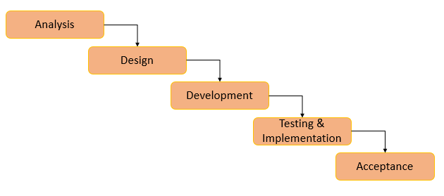
Methodology
Waterfall
Waterfall model is a breakdown of project activities into linear sequential phases
Every phase has to be completed before the next phase starts and there is no overlapping of the phases.

Slide 6
Project’s Progress Planning
Current Progress Goals
Task Name | Duration | Start | Finish
1. Project Brief | 55 days | Sun 14/7/19 | Fri 6/9/19
1.1 Research Documentation | 20 days | Sun 14/7/19 | Fri 2/8/19
1.2 Project Planning | 15 days | Fri 2/8/19 | Sat 17/8/19
1.3 Initial Report | 20 days | Sat 17/8/19 | Fri 6/9/19
2. Analysis | 50 days | Fri 6/9/19 | Fri 25/10/19
2.1 Functional | 15 days | Fri 6/9/19 | Fri 20/9/19
2.2 Non-Functional | 15 days | Fri 20/9/19 | Sat 5/10/19
2.3 Scope of Project | 20 days | Sat 5/10/19 | Fri 25/10/19
3. Design | 65 days | Fri 25/10/19 | Fri 27/12/19
3.1 Documentation Preparation | 20 days | Fri 25/10/19 | Wed 13/11/19
3.2 Entity Relation Diagram | 15 days | Wed 13/11/19 | Thu 28/11/19
3.3 Database Design | 15 days | Thu 28/11/19 | Fri 13/12/19
3.4 System Design | 15 days | Fri 13/12/19 | Fri 27/12/19

Slide 7
Project’s Progress Planning
Next Progress Goals
Task Name | Duration | Start | Finish
4. Development | 80 days | Fri 27/12/19 | Sat 14/3/20
4.1 Designs for System GUI | 20 days | Fri 27/12/19 | Wed 15/1/20
4.2 Develop for small components | 20 days | Wed 15/1/20 | Tue 4/2/20
4.3 Develop for Database system | 20 days | Tue 4/2/20 | Sun 23/2/20
4.4 Integration of Components | 20 days | Sun 23/2/20 | Sat 14/3/20
5. Testing & Implementation | 60 days | Sat 14/3/20 | Mon 11/5/20
5.1 Testing for the Systems | 20 days | Sat 14/3/20 | Thu 2/4/20
5.2 Implement for the Systems | 20 days | Thu 2/4/20 | Wed 22/4/20
5.3 Review | 20 days | Wed 22/4/20 | Mon 11/5/20
6. Acceptance | 42 days | Mon 11/5/20 | Mon 21/6/20
6.1 Project Deliverable | 41 days | Mon 11/5/20 | Sat 20/6/20
6.2 Presentation | 1 day | Sat 20/6/20 | Sun 21/6/20

Slide 8



Proposed approach and method
Integrated = Visual Studio 2015
development
environment
(IDE)
Database = Microsoft SQL Server 2012
Management
Systems
(DBMS)
Programming = C# with ASP.net
Language

Slide 9
Requirements – Development Tools
Visual Studio 2015 System Requirements
1.6 GHz or faster processor
1 GB of RAM (1.5 GB if running on a virtual machine)
4 GB of available hard disk space
5400 RPM hard disk drive
DirectX 9-capable video card (1024 x 768 or higher resolution)
Supported operating systems:
Windows 10, Windows 8.1, Windows 8, Windows 7 SP 1, Windows Server 2012 R2, Windows Server 2012, Windows Server 2008 R2 SP1

Slide 10
Requirements – Development Tools
SQL Server 2012 Management Studio Requirements
32-bit systems
Computer with Intel or compatible 1GHz or faster processor (2 GHz or faster is recommended.)
64-bit systems
1.4 GHz or faster processor
Minimum of 512 MB of RAM (2 GB or more is recommended.)
2.2 GB of available hard disk space
Supported operating systems:
Windows 7, Windows Server 2008 R2 / Service Pack 2, Windows Vista Service Pack 2

Slide 11
Requirements - Hardware
Hardware Requirement
Computer with Intel or compatible 1GHz or faster processor (2 GHz or faster is recommended.)
Minimum of 512 MB of RAM (2 GB or more is recommended.)
Minimum 120GB of available hard disk space
Operation Systems requirement at least Windows 7 or later.

Slide 12
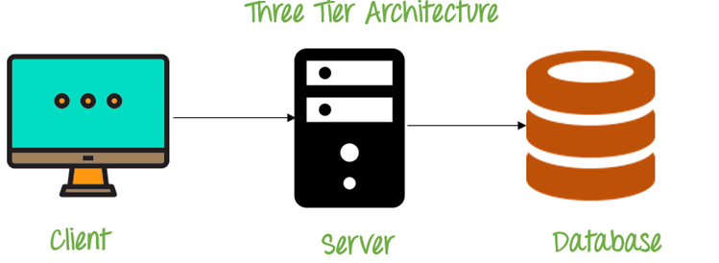
ARCHITECTURE

Slide 13
Case Diagrams – Tutor/Examiner
Update result
View Quiz
Create New Quiz
Prepare Quiz Information
Enter New Question
Login Through Website
Enter Question’s Answers

Slide 14
Case Diagrams – Student/Candidate
Login
Start the exam
Choose the correct answer
Save answer for next Question
Check Result

Slide 15
Entity Relational (ER) Diagram
User ID
USER
Email
Is a
Student
Add
Admin
T-question
Add
Q: number
Assigned to
T-Marks
Attend
Start time
Course
Quiz
End time
Has
Start date
Course ID
Course Name
End date

Slide 16
Entity Relational (ER) Diagram
Continue…
Quiz
Q:- level
Include
Marks
Q: - number
Result
Subject ID
Answer
Question
Question
Option 3
Option 1
Option 2
Option 4

Slide 17
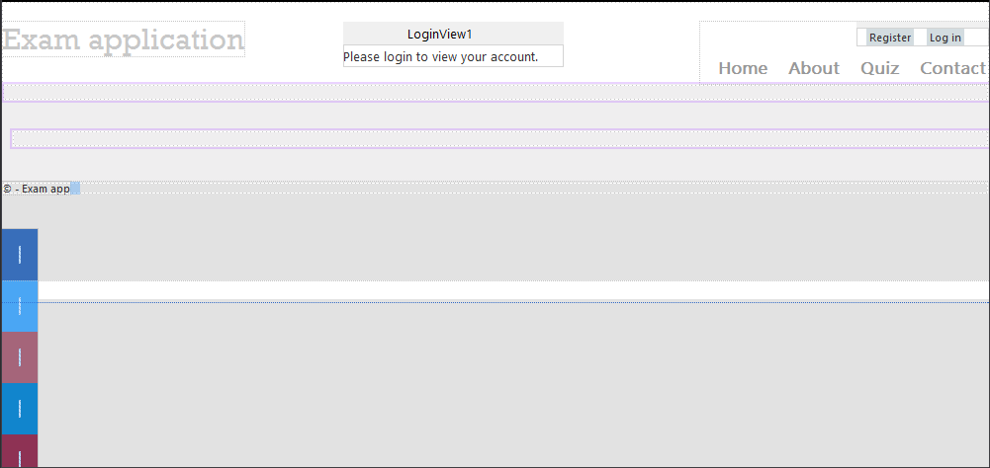
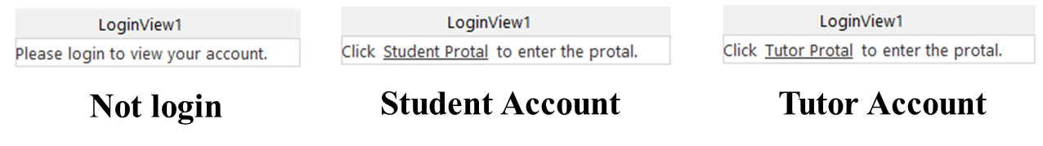
System – Screen Shot
Master Page

Slide 18
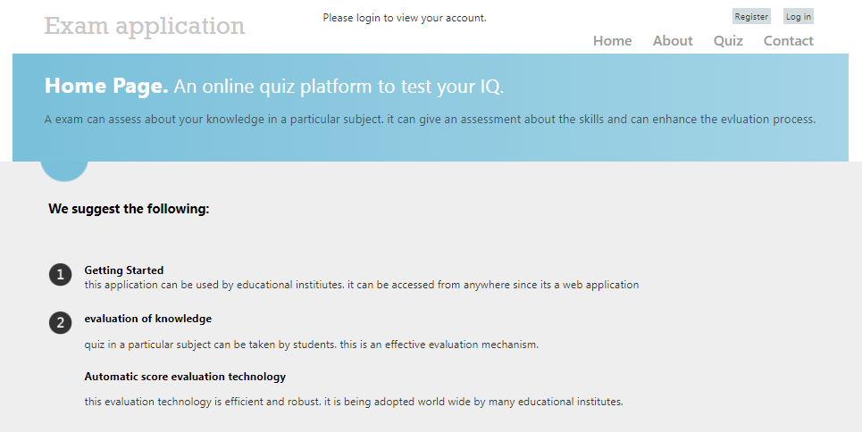
System – Screen Shot
Default page

Slide 19
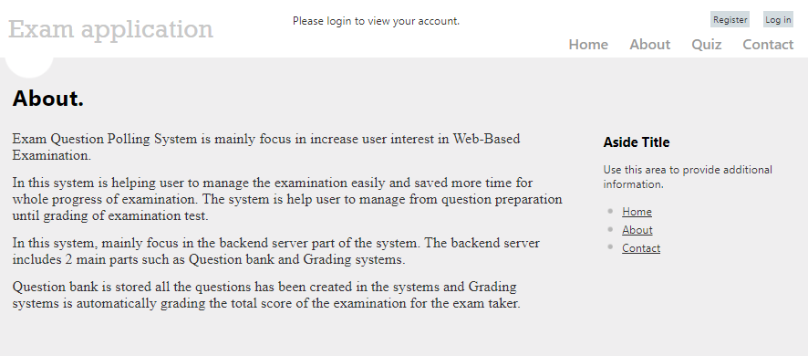
System – Screen Shot
About page

Slide 20
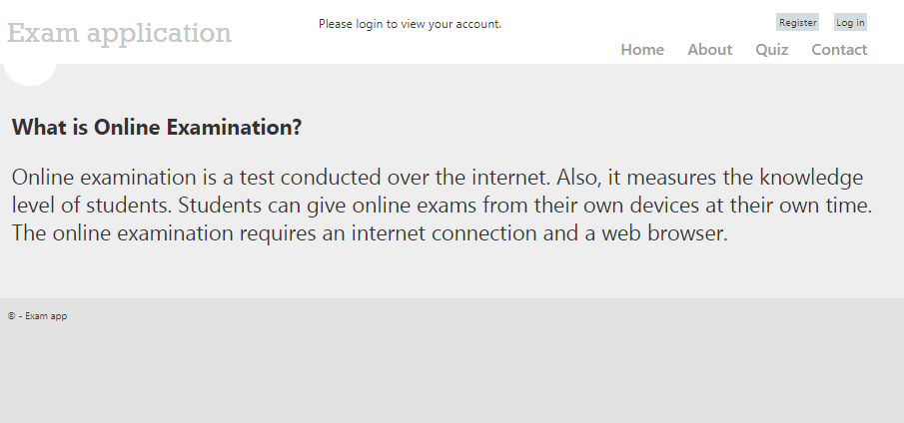
System – Screen Shot
Quiz page

Slide 21
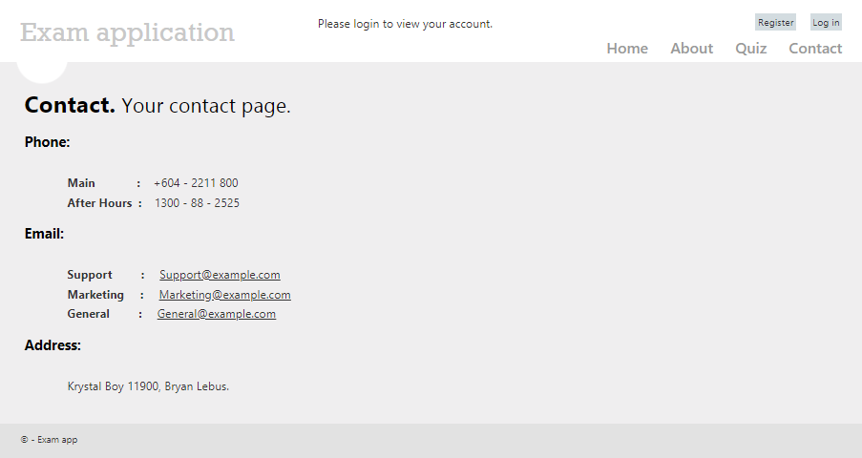
System – Screen Shot
Contact page

Slide 22
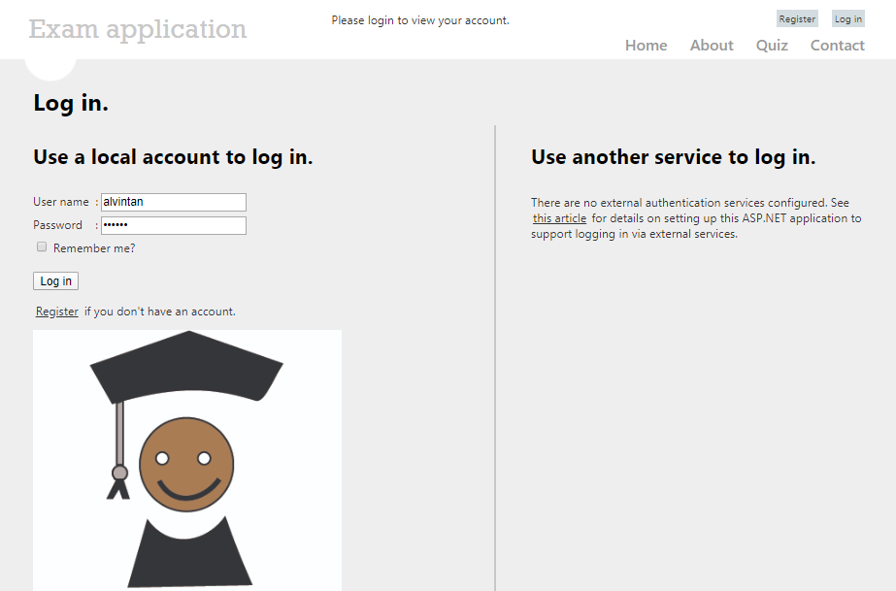
System – Screen Shot
Login page

Slide 23
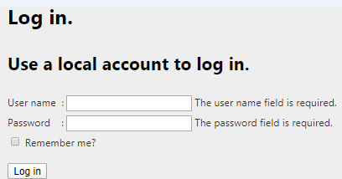
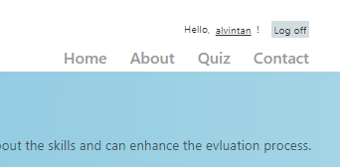
System – Screen Shot
Login page – continue
Login Successful
Validation for Login

Slide 24
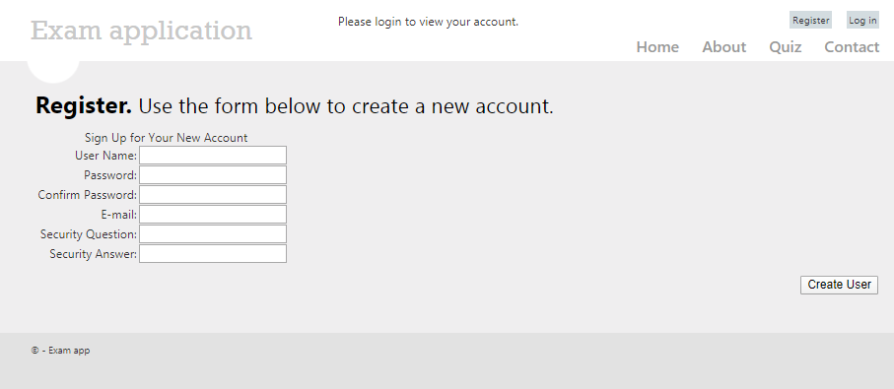
System – Screen Shot
Register page

Slide 25
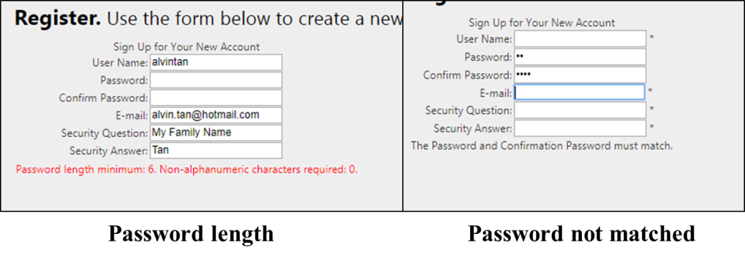
System – Screen Shot
Register page - Validation

Slide 26
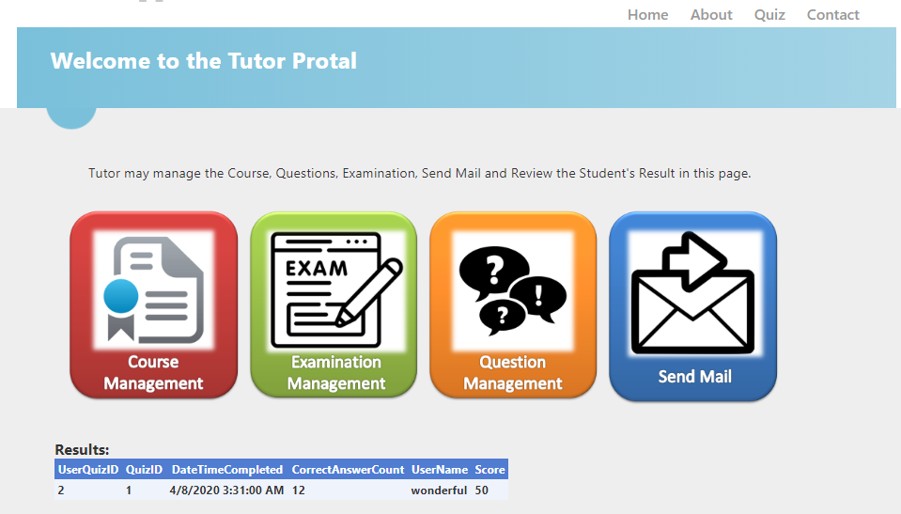
System – Screen Shot
Tutor Page

Slide 27
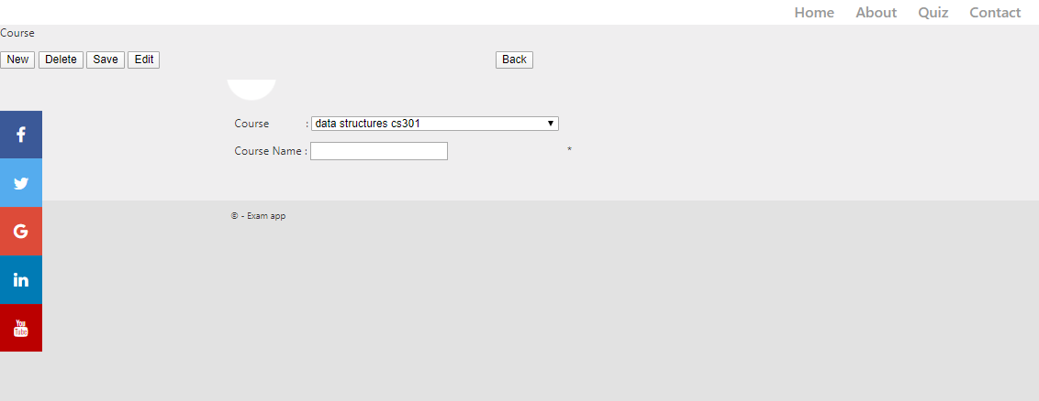
System – Screen Shot
Course Management Page

Slide 28
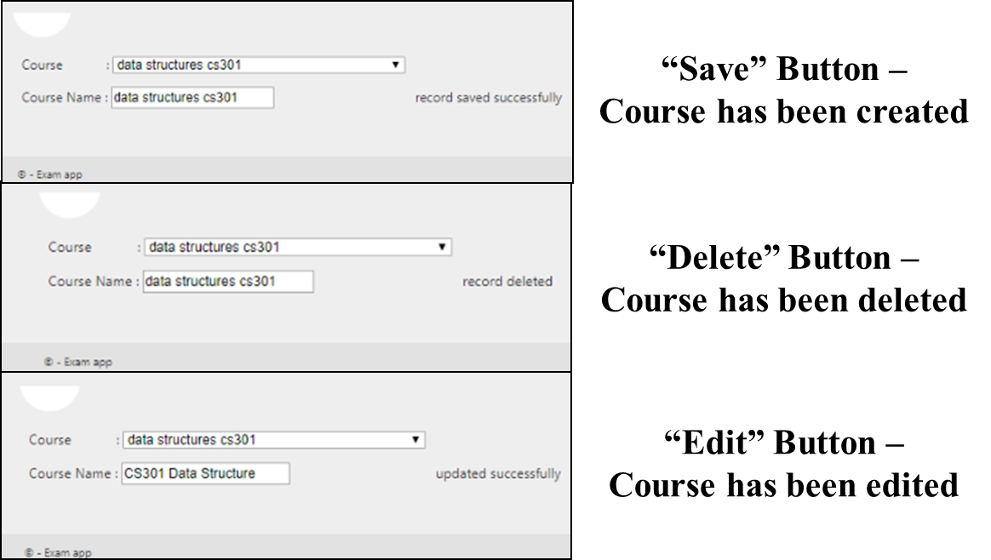
System – Screen Shot
Course Management Page - Status

Slide 29
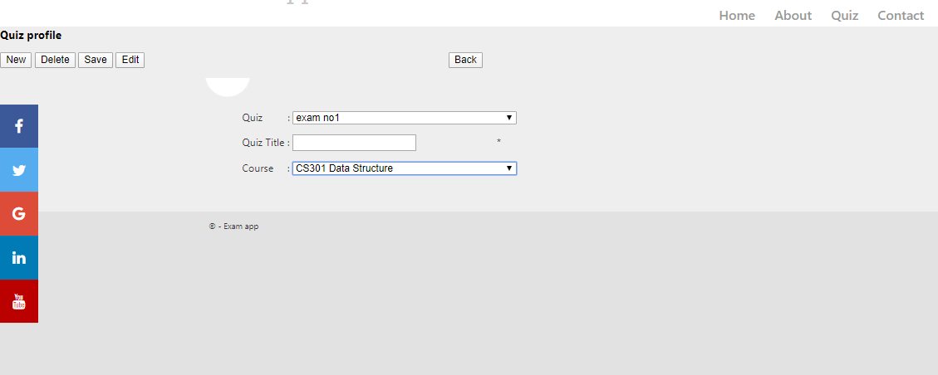
System – Screen Shot
Examination Management Page

Slide 30
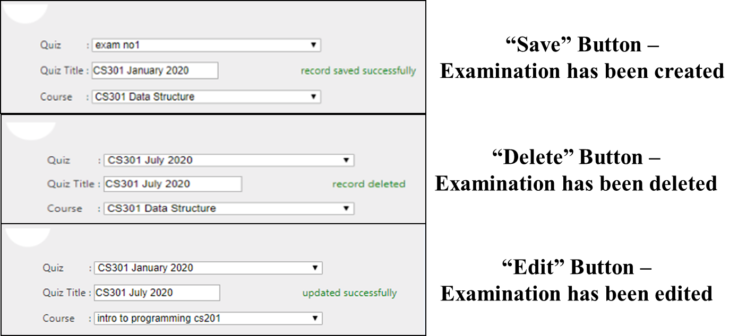
System – Screen Shot
Examination Management Page - Status

Slide 31
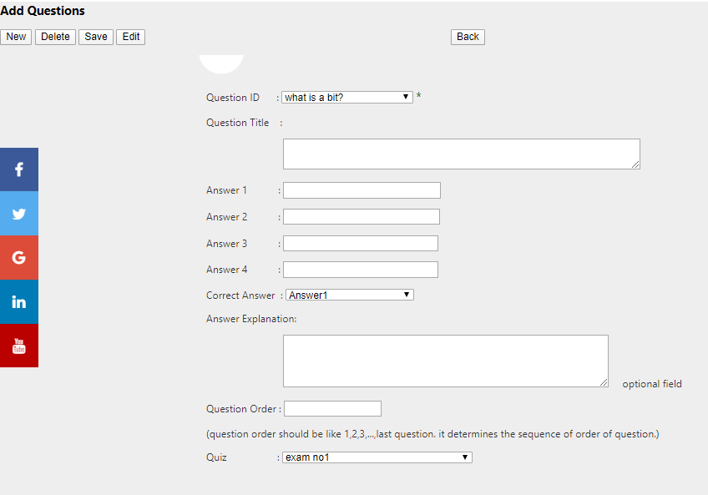
System – Screen Shot
Question Management Page

Slide 32
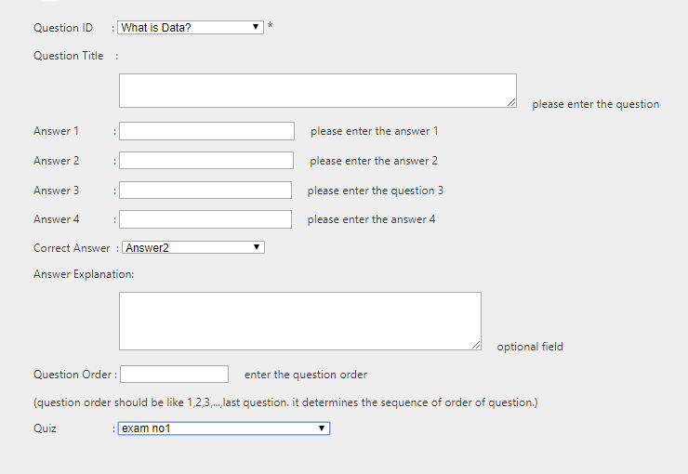
System – Screen Shot
Question Management Page - Validation

Slide 33
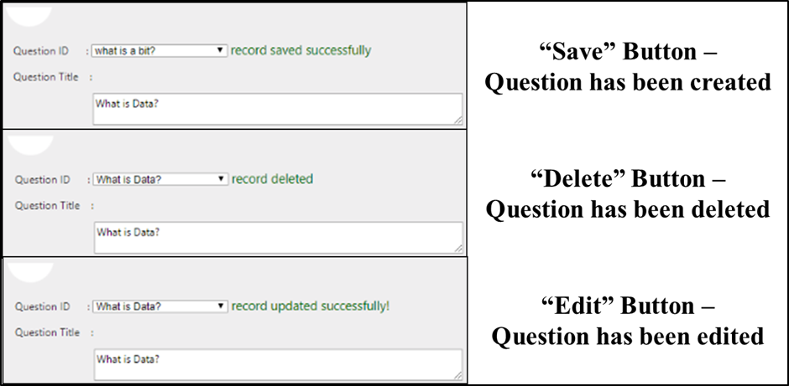
System – Screen Shot
Question Management Page - Status

Slide 34
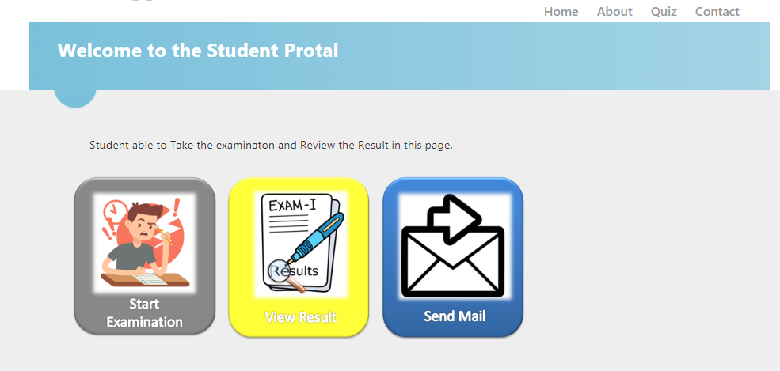
System – Screen Shot
Student Page

Slide 35
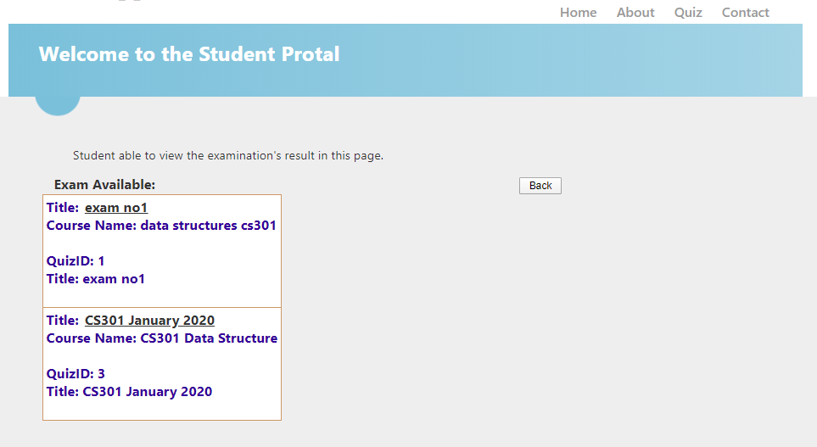
System – Screen Shot
Start Exam Page

Slide 36
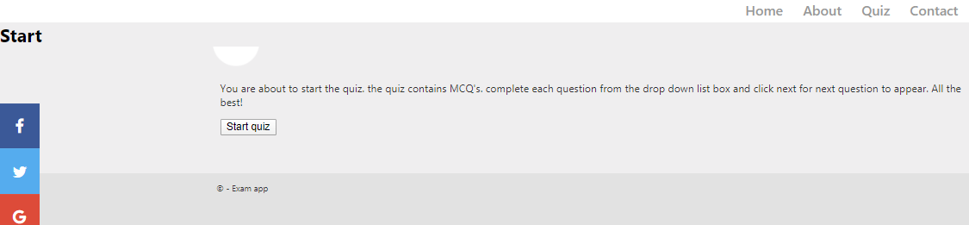
System – Screen Shot
Start Exam Page - continue

Slide 37
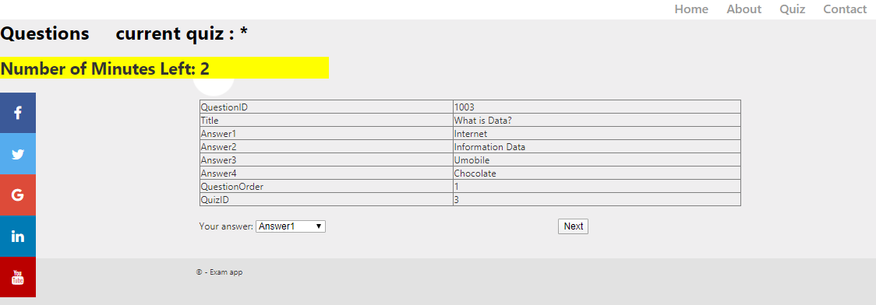

System – Screen Shot
Examination Page

Slide 38
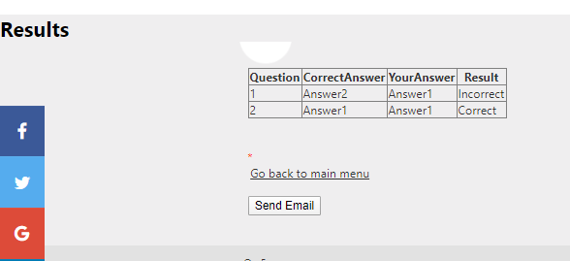
System – Screen Shot
End of Examination Page

Slide 39
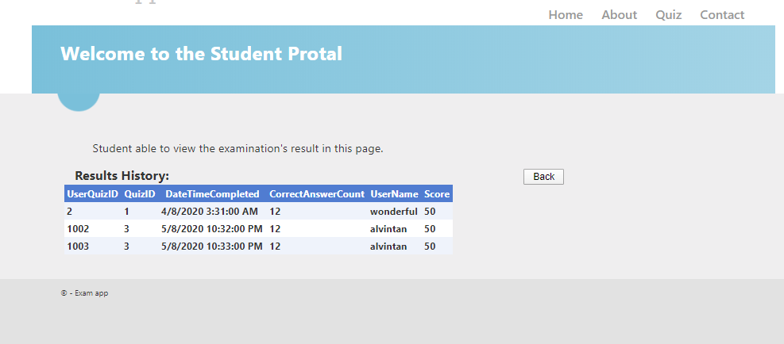
System – Screen Shot
View Result Page

Slide 40
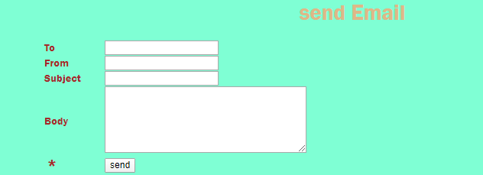
System – Screen Shot
Mailing systems - Validation

Slide 41
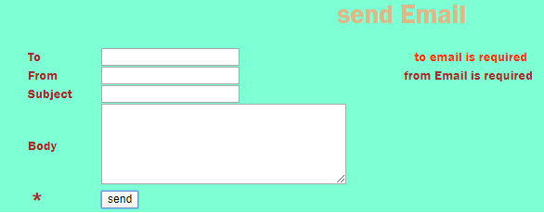
System – Screen Shot
Mailing systems

Slide 42
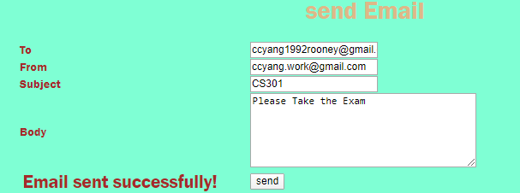
System – Screen Shot
Mailing systems - Successful

Slide 43
Conclusion
Helping user manage the examination Computer-based with Web Browser.
Manage the examination without paper.
Easy to manage the Examination.
Improve the processing time for the examination.
Help user to reduce cost in Examination progress.

Slide 44

Question and Answer

Slide 45

The End
Thank You!
Chooi Chun Yang
Email : chooichunyang@gmail.com

Slide 46
External Link
YouTube channel
PlayList
https://www.youtube.com/playlist?list=PLOzzUzSbX-_Z9whh4jwQT3z06fl0QToHS
Video
http://youtube.com/watch?v=89xSgJN72Zw&list=PLOzzUzSbX-_Z9whh4jwQT3z06fl0QToHS&index=1
https://www.youtube.com/watch?v=8ZzfdFnHjKA&list=PLOzzUzSbX-_Z9whh4jwQT3z06fl0QToHS&index=2
https://www.youtube.com/watch?v=wLp26UG39cw&list=PLOzzUzSbX-_Z9whh4jwQT3z06fl0QToHS&index=3
GitHub
Source Code
https://github.com/yang0744/ExamQuestionPollingSystems

